Slide 1
上机：0-1回归

Slide 2
Example
In the late 1980s, the US Geological Survey (USGS) conducted a water quality study of land on Long Island, New York (Eckhardt et al., 1989). As part of the study, results were presented on contamination of the groundwater by the industrial solvent trichloroethylene (TCE) (工业溶剂三氯乙烯).
We have Y = number of wells (水源) where TCE was detected, out of N sampled wells in total. Also recorded for use as potential predictor variables were:
x_{i1} = land use (with 10 different categories: undeveloped (undev), agriculture (agri), low-density
residential with less than 2 dwellings (房屋)/acre (resL), medium-density residential with
2-4 dwellings/acre (resM), high-density residential with greater than 4 dwellings/acre
(resH), recreation (recr), institution (inst), transportation (trans), commercial (comm), and
industrial (indus))
x_{i2} = whether or not sewers (下水道) were used in the area around the well
Interest existed in identifying if and how these predictor variables affect TCE contamination.

Slide 3
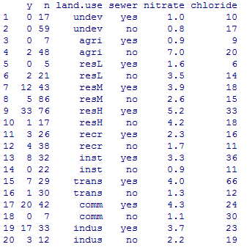
Read in the dataset using R
tce=read.csv("E:/数据分析和统计软件/Lecture 5 上机数据/TCE.csv", header=T, sep=',')
tce

Slide 4
We can get a preliminary sense of the importance of the categorical predictors with a dot plot of the raw success probabilities for each category.
library(lattice)
dotplot(land.use~y/n, col=as.numeric(tce$sewer), data=tce, horizontal=T)

Slide 5
From the graph we see that while there are small differences with respect to land type there are some large effects associated with the presence (red) or absence (black) of sewers.

Slide 6
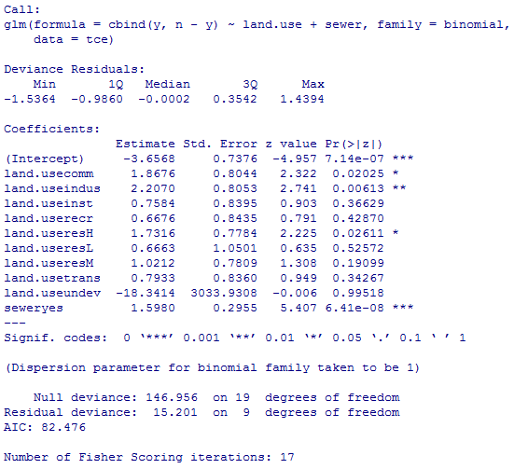
Build logistic regression model
model1 <- glm(cbind(y,n-y) ~ land.use + sewer, data=tce, family=binomial)
summary(model1)
Land.useagri as a reference. Observe that land.useagri has the value of the intercept from the model.
Too big!
Deviance for null model
Deviance for current model

Slide 7

The reported standard error for land.useundev in the model is crazy. The estimated logit for the undeveloped land use category is –22 with a standard error of 3000 yielding a p-value of 1. This indicates that glm failed to estimate this parameter.
If we look at the raw data we can see why this has happened.
tce[tce$land.use=='undev',]
This is the only land use category for which this happened.
tapply(tce$y, tce$land.use,sum)

Slide 8
Both binomial observations in the undeveloped land use category had 0 successes, i.e., no contaminated wells. With no successes the maximum likelihood estimate of the probability of success for this category should be zero. This also corresponds to an odds of zero. Because the log of zero is undefined, the logit is undefined for this group thus leading to estimation problems for this parameter in the logit model. The problem described here is called complete separation and occurs any time a parameter in the model corresponds to a set of observations that are all successes or all failures.
Solution: We can combine the undeveloped land use category with another similar category (either theoretically similar or empirically similar) and refit the model or we can remove the undeveloped category from the model and estimate it separately.

Slide 9
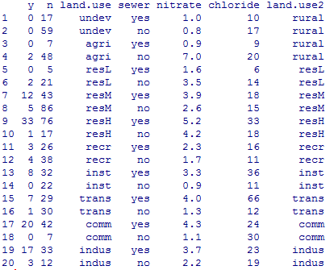
tapply(tce$y, tce$land.use, sum)/tapply(tce$n, tce$land.use, sum)
tce$land.use2 <- factor(ifelse(tce$land.use %in% c('undev', 'agri'), 'rural', as.character(tce$land.use)))
tce

Slide 10
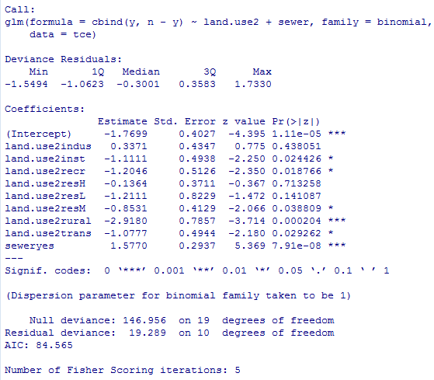
model2 <- glm(cbind(y,n-y) ~ land.use2 + sewer, data=tce, family=binomial)
summary(model2)

Slide 11
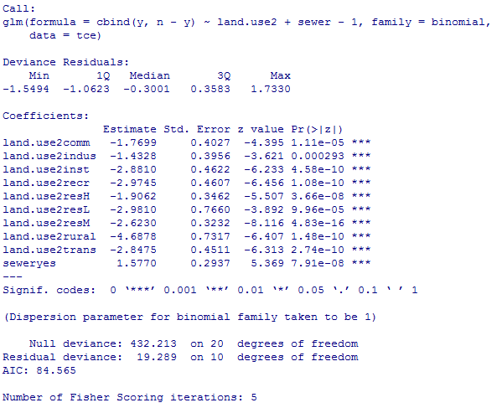
Compare the nine landuses' effects on log odds of contamination
Refit the model 2, without the constant term:
model2 <- glm(cbind(y,n-y) ~ land.use2 + sewer-1, data=tce, family=binomial)
summary(model2)

Slide 12
dotplot(coef(model2)[1:9], xlab='Log odds of contamination')
The logits fall into three groups:
The rural category stands alone but then there are five categories all with logits around –3 and three categories with logits that are larger than –2.
These last three all seem to represent high intensity land use: commercial, industrial, and high-density residential.
The other five perhaps represent an intermediate level of use intensity.

Slide 13
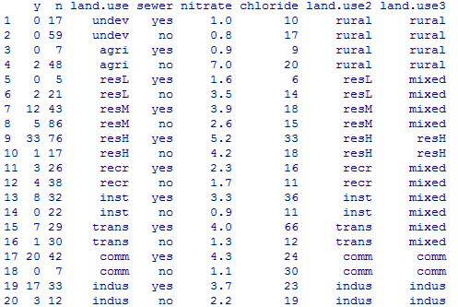
Re-categorization
First combine the five middle categories:
tce$land.use3 <- factor(ifelse(tce$land.use2 %in% c('inst', 'recr', 'resL', 'resM', 'trans'), 'mixed', as.character(tce$land.use2)))
tce

Slide 14
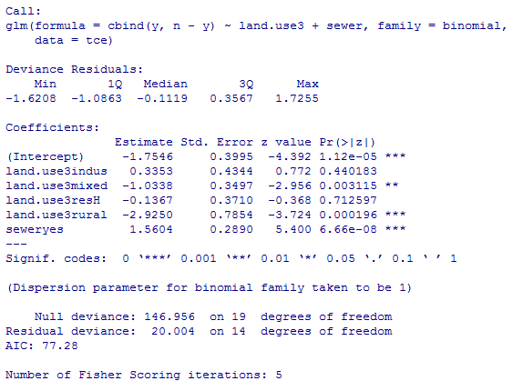
Refit model with new land use variable
model3<- glm(cbind(y,n-y) ~ land.use3 + sewer-1, data=tce, family=binomial)
summary(model3)

Slide 15
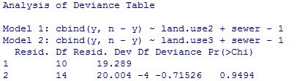
Compare model 3 and model 2
Compare AICs:
sapply(list(model2, model3), AIC)
AIC says we have a better model
Compare log-likelihoods
sapply(list(model2, model3), logLik)
Observe that the log-likelihoods of the two models are barely different.
Compare deviances
anova(model2, model3, test='Chisq')
we fail to find a significant difference.

Slide 16
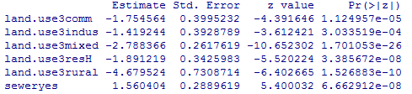
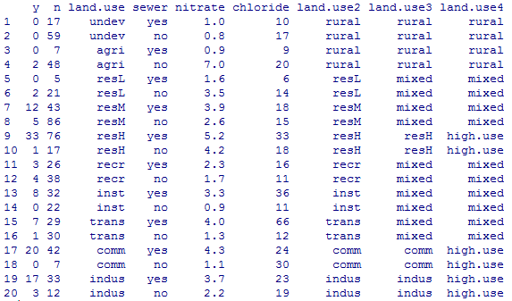
Further combine the three high intensity use into a single category
summary(model3)$coefficients
tce$land.use4 <- factor(ifelse(tce$land.use3 %in% c('resH','comm','indus'), 'high.use', as.character(tce$land.use3)))
tce
The three estimated logits from the high intensity use categories are not very different ranging from –1.4 to –1.9.

Slide 17
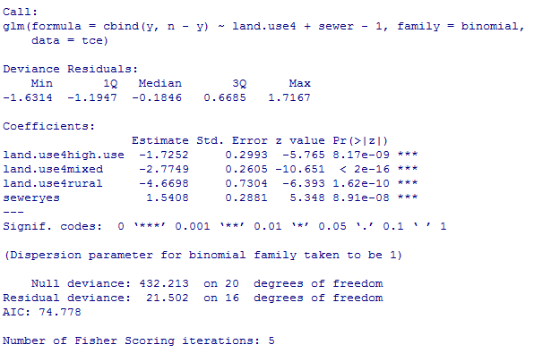
Refit the model with three land use categories
model4 <- glm(cbind(y,n-y) ~ land.use4 + sewer-1, data=tce, family=binomial)
summary(model4)

Slide 18
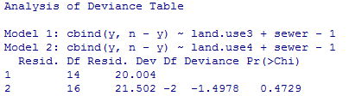
Compare the three models
sapply(list(model2, model3, model4), AIC)
This is the best model so far. AIC argues for the simplest model with three land use categories. A likelihood ratio test also agrees.
anova( model3, model4, test='Chisq')

Slide 19
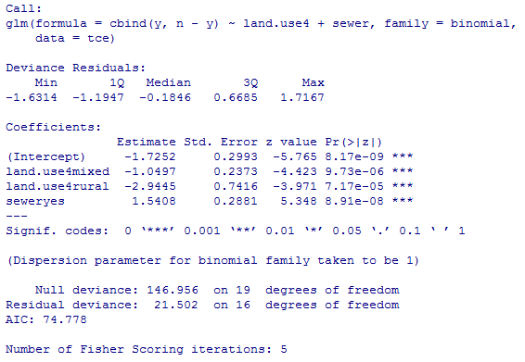
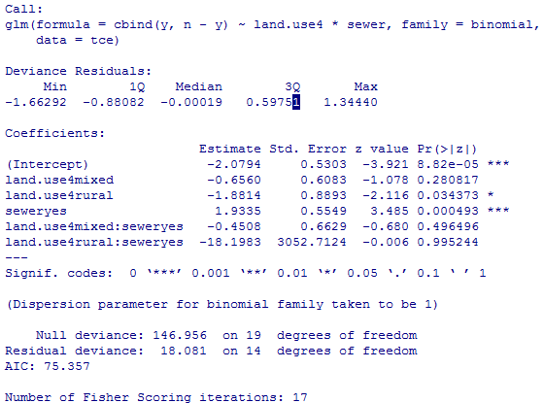
Interaction between land use and sewer
model4<- glm(cbind(y,n-y) ~ land.use4 + sewer, data=tce, family=binomial)
summary(model4)
model5 <- glm(cbind(y,n-y) ~ land.use4*sewer, data=tce, family=binomial)
summary(model5)

Slide 20
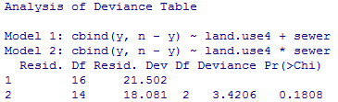
Compare model 4 and model 5
anova(model4, model5, test='Chisq')
sapply(list(model4, model5), AIC)
The interaction term is not significant so we can stay with the main effects model.

Slide 21
Overdispersion in binary/binomial models
Overdispersion means that the variance of the response is larger than would be expected for the chosen model.
For binomial models, the variance of y_{i} =“number of successes” is nπ_{i} (1 − π_{i} ).
The variance of y_{i} /n_{i} is π_{i} (1−π_{i})/n_{i} .

Slide 22
Overdispersion
model4$deviance/model4$df.residual
[1] 1.343856
we would say based on the fitted model that the data are overdispersed relative to a binomial distribution meaning that the data show more variability than is predicted by a binomial distribution.

Slide 23
If Y has a binomial distribution with parameters n (number of trials) and p (probability of a success) then theory tells us that
If the data are overdispersed or underdispersed relative to a binomial distribution then we need to correct for this in some way. One approach is to multiply the estimated binomial variance by φ yielding what's called a quasi-binomial model.

Slide 24
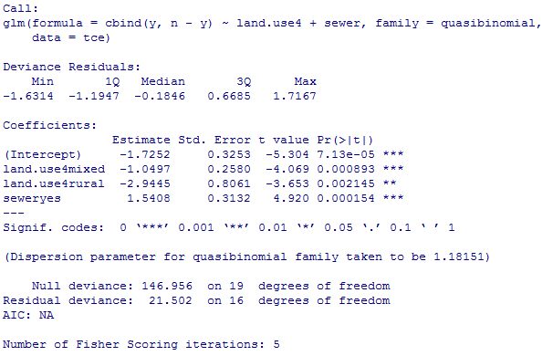
Refit the model using quasibinomial
model6<- glm(cbind(y,n-y)~land.use4 + sewer, data=tce, family=quasibinomial)
summary(model6)
Observe that the parameter estimates of the model 4 and model 6 are exactly the same, but the standard errors and hence the statistical tests are different. All that's happened is that the variances of the parameter estimates in the binomial model have been multiplied by the estimate of φ.
If you do not correct for overdispersion, the estimates of the standard errors are too small which leads to biased inferences, i.e. you will observer smaller p-values than you should and thus make more Type I errors.

Slide 25
One recommendation when there is overdispersion is to include more predictors in the model if possible.
In the dataset tce, we add two constinuous predictors:
x_{i3} = median concentration (mg/L) of nitrate (硝酸盐) at the N
well sites
x_{i4} = median concentration (mg/L) of chloride (漂白粉) at the N
well sites.

Slide 26
Logistic regression with continuous predictors
model7 <- glm(cbind(y,n-y) ~ land.use4 + sewer + nitrate, data=tce, family=binomial)
summary(model7)
model8<- glm(cbind(y,n-y) ~ land.use4 + sewer + chloride, data=tce, family=binomial)
summary(model8)
model9<- glm(cbind(y,n-y) ~ land.use4 + sewer + chloride + nitrate, data=tce, family=binomial)
summary(model9)

Slide 27
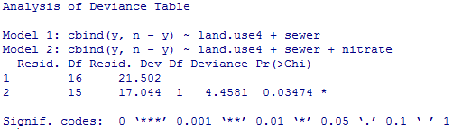
Compare models
sapply(list(model4, model7, model8, model9), AIC)
[1] 74.77762 72.31957 76.57056 74.18337
AIC would suggest that adding nitrate to the model has improved the model, but that the chloride variable is not needed. I test this with a likelihood ratio test.
anova(model4, model7, test='Chisq')
The likelihood ratio test is in agreement with AIC.

Slide 28
Check the overdispersion
model7$deviance/model7$df.residual
model10<- glm(cbind(y,n-y)~land.use4 + sewer + nitrate, data=tce, family=quasibinomial)
summary(model10)

Slide 29
Diagnostic
#deviance residuals
dev_res=residuals(model7)
#Pearson’s residuals
pearson_res=residuals(model7, type="pearson")
plot(dev_res~model7$fitted)
plot(pearson_res~model7$fitted)
plot(dev_res~nitrate, data=tce)
plot(pearson_res~nitrate, data=tce)
n=dim(tce)[1]
index=seq(1:n)
plot(dev_res~index)
plot((pearson_res~index)
#Q-Q plot
plot(model7, which=c(2))

Slide 30
dfbetas=dfbetas(model7)
dffits=dffits(model4)
cooks=cooks.distance(model7)
cbind(dfbetas,dffits,cooks)
par(mfrow=c(1,2))
plot(dffits~index)
plot(model7, which=c(4))

Slide 31
Prediction
predicted logits
predict(model7)
fitted probabilities
fitted(model7)
expected counts under model
expected_y <- fitted(model7)*tce$n
expected_y

Slide 32
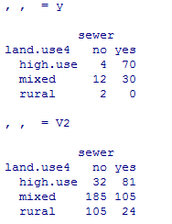
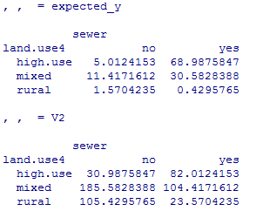
Compare observed and expected
re-tabulate variables
observed<- xtabs(y ~ land.use4 + sewer, data=tce)
Observed
expected <- xtabs(expected_y ~ land.use4 + sewer, data=tce)
expected

